Slide 1

Adventure Works
Insights into Production Scrap and Sales Orders & Business Optimization Strategies
In-depth insights based on production and sales data from fiscal years 2012-2014

Slide 2
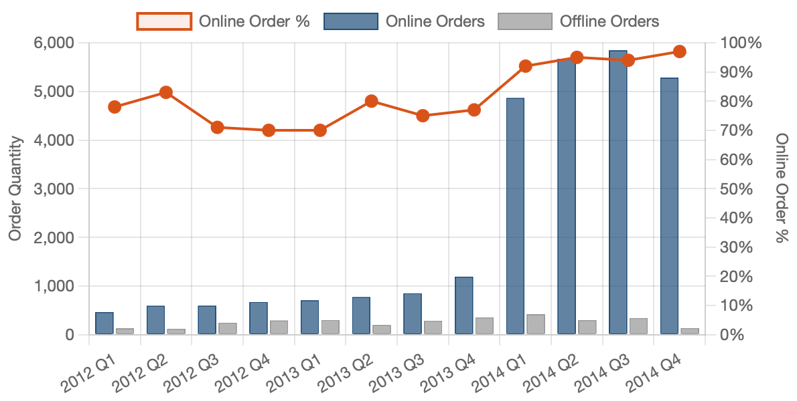
Online Retail Performance
Online Order Trends Chart
Significant Cross-Selling Potential, Product Mix Needs Optimization
45% of orders only include bicycles
"Bicycles + Accessories" most popular (25%)
Other combinations performed relatively weak
Heatmap shows bicycles drive all combination sales

Slide 3
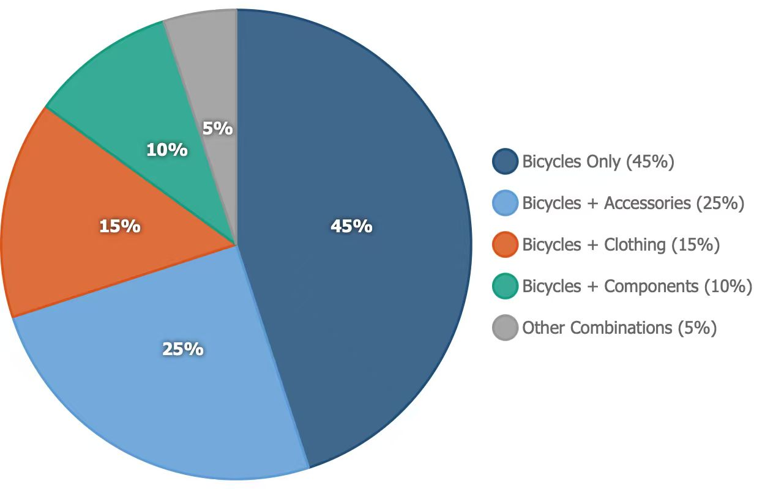
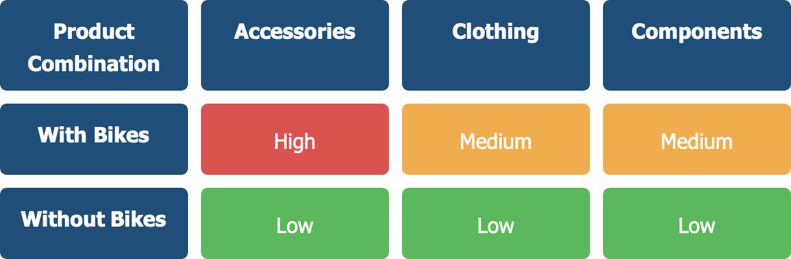
Customer Purchase Patterns
Product Combination Heatmap + Product Mix Distribution Pie Chart
Significant Cross-Selling Potential, Product Mix Needs Optimization
45% of orders only include bicycles
"Bicycles + Accessories" most popular (25%)
Other combinations performed relatively weak
Heatmap shows bicycles drive all combination sales

Slide 4
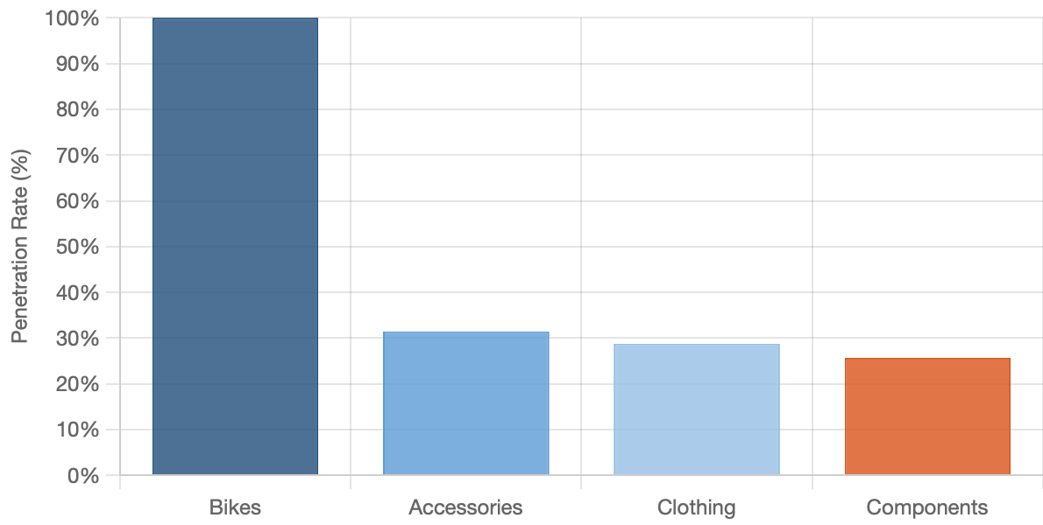

Sales Optimization Opportunities
Low Non-Core Category Penetration, Clear Improvement Room
Online Order Trends Chart
Accessories penetration only 31.5%
Clothing penetration only 28.8%
Components penetration only 25.7%
Far below bicycles' 100% penetration rate

Slide 5

RECOMMENDATIONS
02
"Intelligent Channels + Precise Combination"
01
Online Channels: Invest in developing an "Accessory Recommender". When a customer adds a bicycle to their cart, the system will automatically display the most frequently purchased accessories based on Part II market basket analysis data (e.g., "85% of customers who buy this model also purchased this lock and lighting kit"), and provide a one-click function to add all recommended accessories to the cart.
"Quality Improvement + Online Marketing"
Heat Treatment: Address the frequent occurrence of "Thermoform temperature too high/low" errors in the data by calibrating and upgrading the temperature control systems of all relevant equipment, establishing strict standard operating procedures, and providing retraining for operators.
Offline channels: Equip store sales staff with tablets featuring a built-in "High-Value Bundle Sales Assistant." When a customer purchases a bicycle, the system will prompt the salesperson to recommend a higher-profit, all-category bundle, such as: "Based on inventory, you can recommend this bicycle to the customer, paired with our high-end cycling apparel and GPS components. This bundle currently has an exclusive in-store discount."
04
Machining: Address "Drill size too large/small" and "Drill pattern incorrect" errors by introducing more precise measuring tools and a real-time monitoring system, implementing preventative replacement management for drill bit wear rather than reactive replacement.
Targeted advertising: Target newcomers interested in cycling on social media and search engines, highlighting the convenience of "one-stop shopping"..
Offline: Set up "cycling equipment experience zones" in stores, displaying popular bicycle models alongside matching apparel and helmets to create a complete cycling scenario. Train sales staff to promote apparel as essential equipment for "enhancing cycling comfort and safety," rather than simply as an accessory.
Data-driven optimization: Use website analytics tools to track which accessories and bicycle combinations have the highest click-through rates and conversion rates, dynamically adjust the package content.

